Slide 1
REINVENTION PARTNER
Digital Core
Delivery May, 2026

Slide 2

Fueling Client Success - Digital Core Delivery
GROWTH PILLARS
01
DISRUPT
02
DEFEND & REIMAGINE
03
FALL FORWARDS
TALENT
Quantum Crew
AI Native Engineers, AI first Enterprise Architects
Quantum Elevate
AI first Learning powered by Ecosystems
Total Quality Reinvention
New competence framework integrated with HackerRank and Codility
RDEs/FDEs
DELIVERY EXCELLENCE
Integrated Delivery with RP’s & IDL
Elite Client Delivery Leads
Delivery Through Codified Methods Through Method One
WorkBench by Ecosystem and Industry (Accenture Reinvention.AI | Custom | Hybrid)
ASSETS POWERED BY OFFERINGS
Reinvention.ai
Code Archeology – Analysis Engine | Domain Ontologies/Data Models Analysis Engine | Context Engine by Industry Analysis Engine | Adaptive Reference Architectures by Industry Decisioning And Execution Engine | AI foundations by Ecosystem partner Decisioning and Execution Engine
Ecosystem partners

Slide 3
  Enterprise Op Model & Human Capital
How Accenture is reshaping the workforce
Accenture is reshaping the workforce towards an autonomous delivery model with human in the lead.
Digital crews
Engineering leads
Service leads
Elastic technical services (ETS)
Quantum crews
Delivery leads
Eng. leads/L3 engineers
L2 engineers
L1.5 engineers
Agent developers
Platform engineers
Quantum crews: Multi-skilled engineers focus on work not performed or largely associated with agentic capabilities
Platform engineers: Manage and govern the agentic and automation platform
Agent developers: Build, manage and optimize agents, including cost optimization
ETS (elastic technical services): Single / multi-skilled delivery services using agentic capabilities
Digital crew: AI agentic / capabilities support delivery

Slide 4
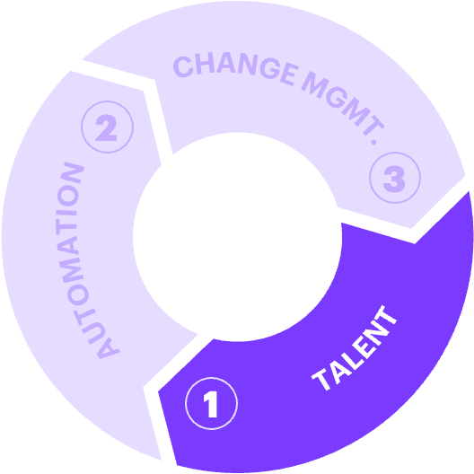




1. To deliver on this promise, we’re transforming the fabric of our talent — building a pool of 200K cognitive AI engineers and delivery reinventors.
FULL STACK ENGINEERING
…
SAP
Custom
Programming
Java, .NET
Python
Scala
GoLang
NodeJS
Back End
Spring Framework
Django, web2py, flask
Streaming (Kafka, Pulsar)
Integration Engineering
Containers
Cloud Skills
Cloud Foundation
Cloud Operations, FinOPS
Cloud Transformation
Cloud Integrations
Cloud Services, Orchestration
Data Skills
NoSQL (mongo, cockroach)
SQL (oracle and Cloud native)
Semantic Graphs
Front End
Angular JS
React JS
Next JS
Amber JS
Material UI
AI AUGMENTED ENGINEERING
Generative AI Foundation
AI/ ML
Gen AI APIs for Applications
Gen AI Essentials
Gen AI Transformer Models & Foundational Elements to start building use cases – Prompt Engineering, Chain of Thought, IDE Prompting, Prompt Library
Generative AI in TDLC + Assets
AI-Assisted development
Gen AI in Knowledge Mgmt.
Gen AI in AMS/ IMS/ SI, Data, etc.
Gen AI for Platforms – SAP, Oracle, …
Gen AI use cases with GenWizard
Gen AI Advanced - RAG, Fine Tuning
AI Assisted Code Refactoring
Agentic Foundation
Agentic AI 101 & Frameworks
Multi-Agent Systems with Crew AI
AI Agents u/ CrewAI, LanGraph, Symantec Kernel
Building & Evaluating Agents
MCP: Context AI Apps with Anthropic
ACP: Agent Communication Protocol
Vibe Coding
AI for Cloud Engineers
Agents for Observability
AI Assisted Terraform
Vulnerabilities & Landing Zones
E2E Integrations, Terraform
Multi and Hybrid Cloud
Regulatory Tech Frameworks
Accenture Assets
GenWizard
AI-Refinery, etc.
340K
Completions
250K
Completions
FY-24 & FY-25 FOCUS
FY-26 & FY-27 FOCUS
200K Target Completions
PARTNER SPECIFIC ECOSYSTEM TOOLS
OpenAI
Google (DeepMind)
Microsoft
Amazon (AWS)
Anthropic
SAP
SDFC
ChatGPT - GPT-4o, GPT-4
Codex , DALL·E
Gemini Code
Alpha Code
Copilot (Office, GitHub, and more)
Azure OpenAI Service
Amazon Bedrock, Amazon Q, CodeWhisperer
Claude Code
Joule,
Signavio, etc
Agentforce, ..
…
FY-26 & FY-27 FOCUS
200K Target Completions

Slide 5
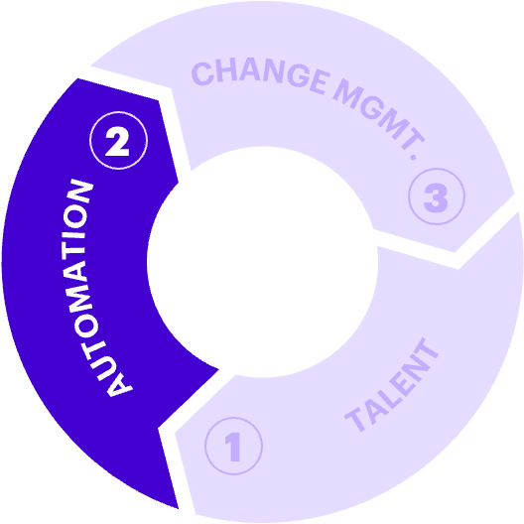
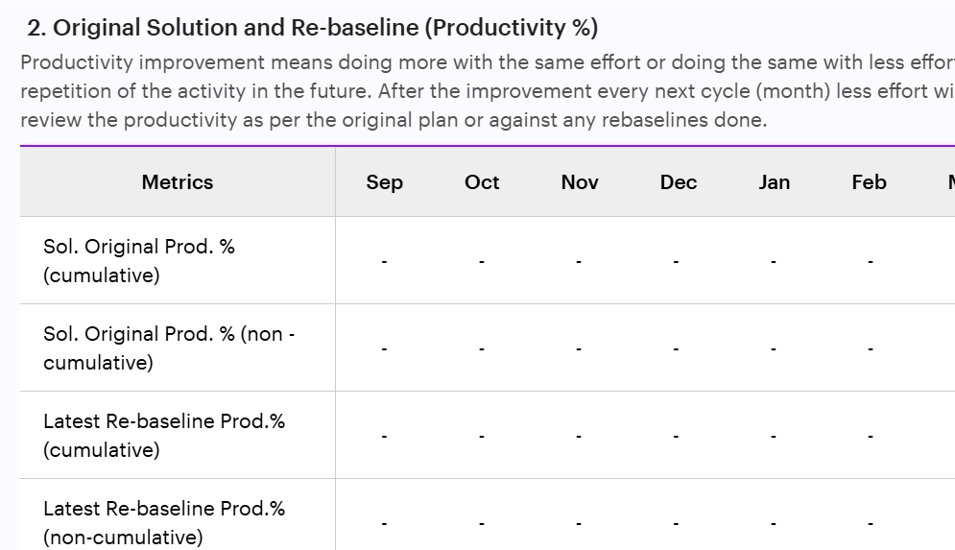
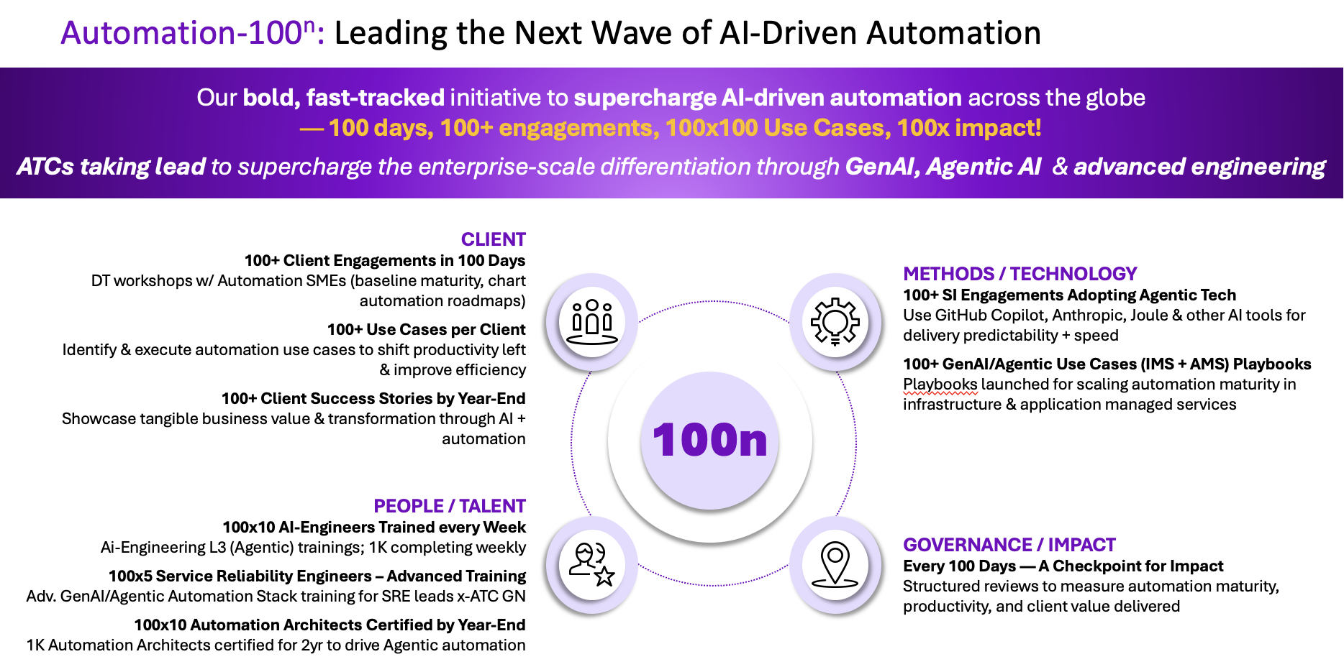
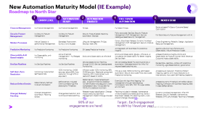
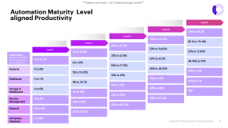
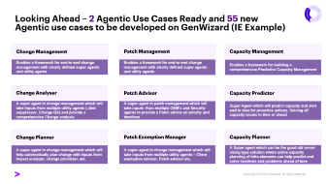
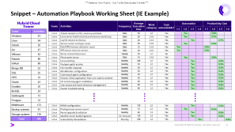
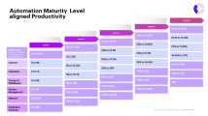
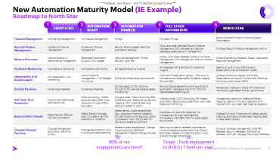
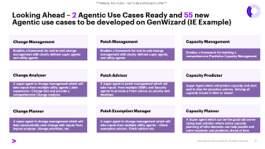
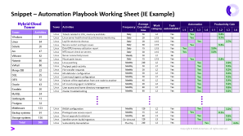
2. With the right talent foundation in place, our next lever of scale is automation — embedding intelligence into every layer of delivery.
AGENTIC AUTOMATION MATURITY FRAMEWORK
A new 5-level framework for
NorthStar , including the journey
to Gen and Agentic AI
MATURITY LEVEL WISE PRODUCTIVITY GUIDELINES
Productivity Guidelines mapped to the type of work and maturity level
GUIDED ACTIVITY WISE AUTOMATION PLAYBOOK
Productivity Guidelines mapped to the type of work and maturity level
AGENTIC USE CASES FOR GENWIZARD
200+ Agentic AI use cases
identified to be developed
on GenWizard
NEW: SOLUTION TO DELIVERY PRODUCTIVITY TRACKING IN MMD
Profitability & Productivity
baseline for all contracts,
with stretch targets
and tracking
AUTOMATION-100^{n}
100 engagements, 100 Design Thinking workshops, 100x100 use cases, 100+ SREs to be trained per ATC, Every 100 days impact measured, 100 Success Stories by FY26

Slide 6


Requirements → Design → Code → Test → Docs → Deploy → Ops
AI helps significantly across each phase, but cycles are still weeks
Materially Faster but still filled with unnecessary ceremonies and Handoffs and approval gates everywhere
AI Powered
26 Sprints/year
Every 2 weeks
Discovery Driven Engineering
250 Cycles/year
Every Day
Specification → Execution → Continuous Ops
Humans make decisions, AI does the work
Exponentially faster. NO sprints, NO standups, NO reviews, NO retrospectives, NO approval gates

Slide 7
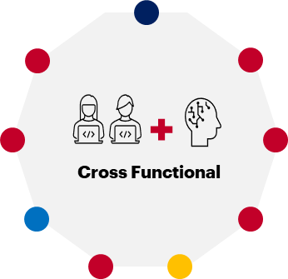
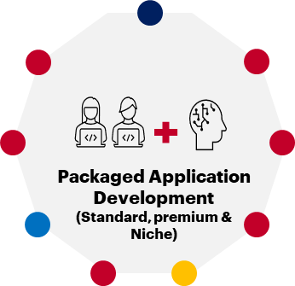
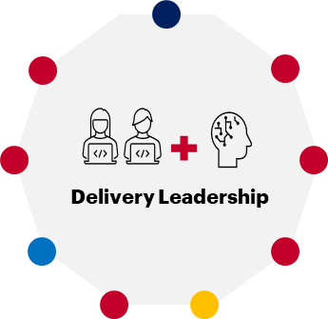
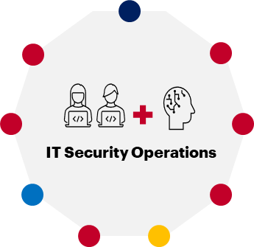
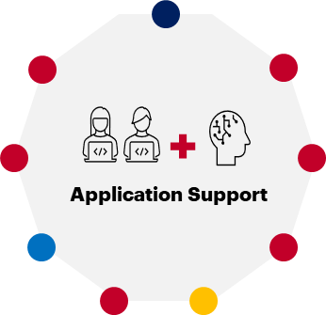
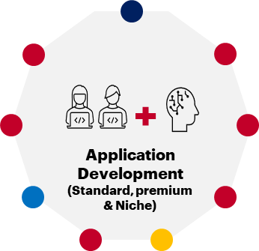
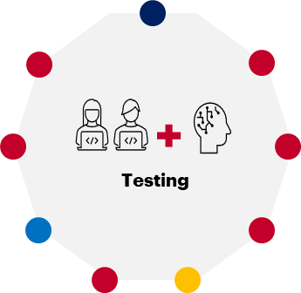
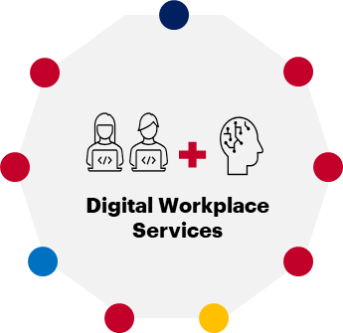
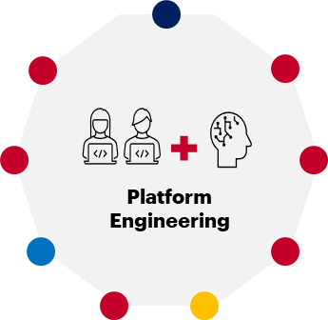
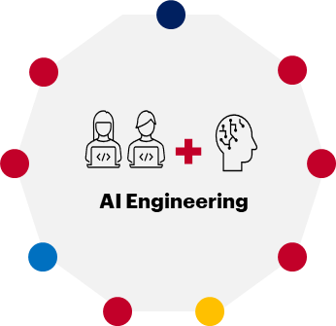
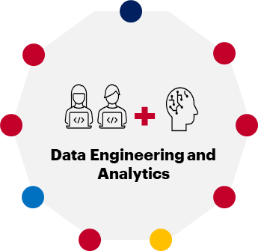
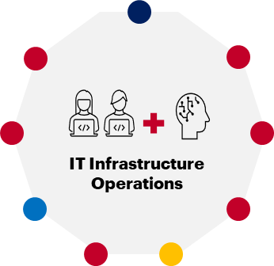
Human + AI Pod Structures (Selected Example)
3 – AI NATIVE DELIVERY APPROACH
Illustrative
How will drive significant productivity improvement by moving at least 50-70% pods to semi-autonomous by end of the third year
Human + AI Pod Structures
Different POD types gradually transform from AI Augmented to Semiautonomous Pods
Custom Application Development (Standard) *
Sr. Developer
Sr Developer
Intent & Specification Engineer
Tech Lead
Tech Lead
Sr AI Engineer
Developers
Developer
Jr. Developers
AI Engineers
AI Engineer
AI Product Engineer
Developer
Developers
Human \ AI
Augmented
Human \ AI
Accelerated
AI Semi-Autonomous
 |  | AI Augmented |  |  | AI Accelerated |  |  | Semi-Autonomous
 |  | S | M | L | S | M | L | S | M | L
Location | Role | FTEs | FTEs | FTEs | FTEs | FTEs | FTEs | FTEs | FTEs | FTEs
USA | Sr. Developer | 0.5 | 1 | 1 |  | 1 | 1
India | Jr. Developer | 1 | 2 | 2 |  |  | 1
India | Developer | 2 | 2 | 3 | 1 | 1 | 2
India | Sr. Developer |  |  | 1
India | Technical Lead | 1 | 1 | 1 |  | 1 | 1 |  | 1 | 1
India | AI Engineer |  |  | 1 | 1 | 1 | 2 | 1 | 1 | 2
India | Sr. AI Engineer |  |  | 1 | 1 | 1 | 1 | 1 | 1 | 1
Brazil | Developer | 0.5 | 1 | 1
Poland | Developer |  | 1 | 1
USA
Nearshore-LATAM
Nearshore- EU
India
* Roles optimized/replaced by AI Agents in Accelerated and Semi – Autonomous PODs

Slide 8
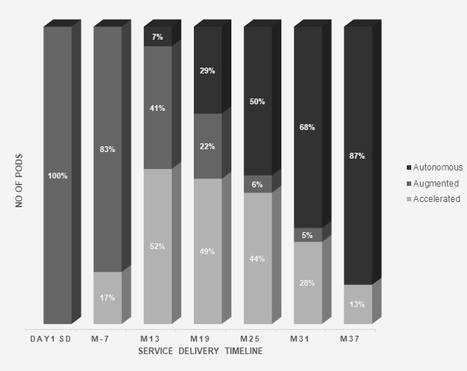
POD Progression to Higher AI Maturity Levels
Progression Roadmap to Higher AI Maturity
Progression to AI-Native,
Semi-Autonomous Delivery ~ Enabling the shift from human-led delivery to AI-native, semi-autonomous execution at scale.
50–70% productivity uplift through AI-enabled PODs
30–40% efficiency gains proven in live use cases
Faster delivery and improved quality via autonomous workflows
From incremental gains to AI-native, outcome-driven delivery at scale.

Slide 9
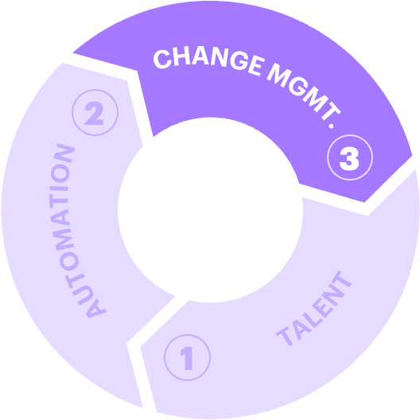
3. To sustain transformation, we’re building a reinvention culture — making ATC GN the best place for reinventors
AI Ready Workforce
2.1 AI-readiness Narrative
2.2 Tech Week & Delivery Summit (Learn it, Live it, Lead it)
3.1 Leadership vision/ Reinvention direction
2.3 Tech Week Team Challenges
AI ready and connected teams
3.2 Automation 100^{n} (100 success stories)
3.3 Engagement connects/ teach backs
1.2 Gen AI Engineer
Agentic Learning
Agentic AI Conversant (global prog.)
Agentic AI Engineer
Agentic AI Expert MasterClass
Accenture Assets University
2.4 Webcasts / Exec Townhalls on being AI ready and GPTW
1.1 TQ++
3.4 Real-time recognition
2.5 Innovation Contest
Shark Tank & Hackathon
3.4 Continuous Listening- Q12, GPTW
1.3 Tech Certifications & AI Certifications
  1. Learn it
1.4 GenWizard university
  2. Live it
  3. Lead it
Adaptive Learning
Empowering every individual to grow with AI, every day
Inspiring Actions
Fuelling curiosity, creativity and AI fluency
New Ways of Working
AI readiness embedded in how we work – reinforced by teams, communities & leaders
Individual
1.5 Role and capability specific learning (incl. Rangers squad, Quantum crew )
2.6 Reimagined ACE Awards
1.6 Curated Content
Udacity; Deep Learning.AI
2.7 Agentic Automation Architect Certification, badge
3.5 Team Experience Collective- Network of team leads and experience champions, Viva engage communities
1.7 Entry Level AI learning
2.9 Spotlight Videos, Client Stories and Career Stories
2.8 GPTW leadership immersions, People Lead Xchange
Best Place
to work for
Reinventors
2.11 Local communities
Together @ Work Fests and Events
3.6 Engagement wise talent leaderboard and recognition
2.10 ‘AI Clubs’ in all locations (myPassion)
xx – launched / in-progress as per plan

Slide 10
New Automation Maturity Model (IE Example)
Roadmap to North Star
1
ENTRY LEVEL
2
3
4
5
AUTOMATION
READY
AUTOMATION
ENABLED
FULL STACK
AUTOMATION
NORTH STAR
Financial Management | No Finance Management | No Finance Management | FinOps | Full Stack FinOps | Revenue based FinOps or Outcome Based Optimization
Security Posture Management | No Security Posture Management | No Security Posture Management | Security Posture based reporting automation, SecOps | Policy as a code, SecOps, Security Posture Management, Drift Management, Service catalogue-based Security management | Full Stack Security Posture Management with AI
Modern Processes | Manual Capacity a performance Management | Blameless Postmortem, SLI/SLO, Error Budget | Lifecycle Management, FinOps, SecOps, Agile, SRE | Canary, Blue Green Release, Dynamic Workload Management, Drift Management, Security Posture Management, | Chaos Engineering, Reliability Design, Application Resource Management,
Predictive Monitoring | No Predictive Monitoring | No Predictive Monitoring | SM based Predictive Analysis | AI Integrated with EventOps for predictive Insights | Agentic AI built on top of End-to-end Observability, Failure Prediction Model,
Observability & AI Based Insights | No Observability, only monitoring | Active threshold management + Full fledged monitoring | End to end Observability at Infra level | End to end Observability @ app + Infra level, AI included at the Observability for Better insights, Service Mesh | Ai Based Predictive Insights, End to end Observability at Product/ Domain level, Revenue, Outcome impact observability,
DevOps Pipelines | No DevOps Pipelines | No DevOps Pipelines | DevOps based CI/CD, Patching through CI/CD, Service Catalog based Provisioning, | Service Catalog Based Provisioning and Day 2 automation, Dedicated branch for Infra, Pull request-based patching, etc. | DevSecOps + SecOps + AIOps with predictive monitoring, Agile Based Delivery governance
Self Heal / Auto Resolution | Monitoring implemented Self heal scripts | 100% monitoring , CMDB accuracy above 95%, Auto resolution through ATR or equivalent | Infra as a code, 100% monitoring, 99% CMDB accuracy, Relational component mapping, APM implemented, Auto resolution based on SOP's | Infra as a code, 100% Monitoring, ARM based automation, Security as a code, Policy as a code, Predictive monitoring | AI based auto resolution, Predictive Pattern mapping, Agentic AI for auto resolution & AI Interventions. Auto Learn Self Healing Capability
Reduce Defect Density | Defect Density Defined No Event Correlation | Defect Density Included Event Correlation @ Infra analytics for Threshold | Defect density Implemented Event Ops , proactive threshold validation, Toil Identification and reduction, Event Compression ratio, 100:2(2 alert for 100 RU) for stable environment | EventOps with App Infra Mapping, Toil management through Agile Backlog, Compression ratio 35%, 100:1 for super stable environment | AI Based Dynamic Threshold with Defect density mapping, Eventops with Business mapping, Best In class Defect density.
Change/ Release/ Patching | Change Management automation, Patching scripts | Change Risk Prediction, End to end automated patching | Release Impact identification, Change impact analyzing, E2E Patch Management, Predict Change induced MI's | Patching included in releases, Maintenance windows based automated patching, Canary/ Blue Green release ( for patching & etc.), Auto prevent change Induced MI's | Dynamic Workload management, Infra NFR Releases, Security Releases, Maintenance Releases, Shift Left changes/ Patching to Releases
90% of our engagements are here!!
Target : Each engagement to shift by 1 level per year!

Slide 11
Automation Maturity Level aligned Productivity
Level 5
Level 4
54% to 64.2%
Level 3
45% to 54.57%
Level 2
60 % to 70.41%
25% to 45.6%
Level 1
52% to 59.85%
52% to 72.85%
5% to 25.8%
Hybrid Cloud = System + Storage+ DB+ Middleware + Cloud platforms
32% to 52.8%
0 to 4.97%
37% to 52.5%
48.45% to 57%
8 to 32%
10% to 37.15%
Systems
0 to 8%
45% to 48.45%
52% to 70%
1% to 10.42%
35% to 45%
Databases
0 to 1 %
35% to 52%
46% to 57%
6% to 35.7%
16% to 35%
Storage & Middleware
0 to 6%
39% to 48%
TBD
3% to 16%
23% to 34%
Service Management
0 to 3%
49% to 61.38%
14% to 16%
22% to 49.24%
Network
2% to 5%
2% to 21.25%
Workplace Solutions
0-1.38%

Slide 12
Snippet – Automation Playbook Working Sheet (IE Example)
Hybrid Cloud
Tower
Tower | Activities | Frequency | Average Execution time | Work category | Task automatable? | Automation |  |  |  | Productivity Gain
 |  |  |  |  |  | L1 | L2 | L3 | L4 | L1 | L2 | L3 | L4
Linux | Tickets related to CPU, memory and disks | Daily | 30 | L2 | Yes |  | Yes |  |  |  | 5.6%
Linux | Linux server health check & performance monitoring | Daily | 20 | L1.5 | Yes |  | Yes |  |  |  | 3.7%
Linux | Log file rotation & cleanup | Daily | 20 | L1.5 | Yes |  |  | Yes |  |  |  | 3.7%
Linux | Service restart and login issues | Daily | 30 | L1.5 | Yes |  | Yes |  |  |  | 5.6%
Linux | Disk/CPU/memory utilization report | Daily | 15 | L1.5 | Yes | Yes |  |  |  | 2.8%
Linux | NFS mount check on servers | Daily | 30 | L1.5 | Yes | Yes |  |  |  | 5.6%
Linux | Server connectivity issues | Weekly | 30 | L2 | No
Linux | Mount point issues | Daily | 15 | L1.5 | Yes |  | Yes |  |  |  | 2.8%
Linux | Linux patching | Monthly | 240 | L2 | Yes |  |  | Yes |  |  |  | 2.2%
Linux | Pre/post patch activity | Monthly | 30 | L2 | Yes |  |  | Yes |  |  |  | 0.3%
Linux | File transfer requests | Monthly | 30 | L2 | Yes |  |  | Yes |  |  |  | 0.3%
Linux | MS defender configuration | Monthly | 30 | L2 | Yes |  |  | Yes |  |  |  | 0.3%
Linux | Commvault agent configuration | Monthly | 30 | L2 | Yes |  |  | Yes |  |  |  | 0.3%
Linux | Failover of the application from one node to another | Monthly | 45 | L2 | Yes |  |  | Yes |  |  |  | 0.4%
Linux | HP monitoring agent installation | Monthly | 20 | L2 | Yes |  |  | Yes |  |  |  | 0.2%
Linux | User access and home directory management | Monthly | 60 | L2 | Yes |  |  | Yes |  |  |  | 0.6%
Linux | Cluster troubleshooting | Monthly | 60 | L3 | Yes |  |  | Yes |  |  |  | 0.6%
Linux | RHSM configuration | Monthly | 120 | L2 | Yes |  |  | Yes |  |  |  | 1.1%
Linux | Privileged user access report | Monthly | 15 | L2 | Yes |  | Yes |  |  |  | 0.1%
Linux | Kernel upgrade & validation | Monthly | 60 | L3 | Yes |  |  | Yes |  |  |  | 0.6%
Linux | Satellite server build/migration | On-demand | 120 | L3 | Yes |  |  | Yes |  |  |  | 2.2%
Linux | Vulnerability Remediation | Monthly | 240 | L3 | Yes |  |  |  | Yes |  |  |  | 4.4%
Tower | Activities
Windows | 91
Linux | 54
Solaris | 20
Aix | 47
VMware | 52
Nutanix | 80
VxRail | 80
Mongo DB | 22
SQL | 25
OES | 32
Oracle | 43
Exadata | 20
MySQL | 24
Goldengate | 13
Postgres | 33
Middleware | 123
Backup systems | 91
Storage systems | 136
Total | 986

Slide 13
Looking Ahead – 2 Agentic Use Cases Ready and 55 new Agentic use cases to be developed on GenWizard (IE Example)
Change Management
Patch Management
Capacity Management
Enables a framework for end-to-end change management with clearly defined super agents and utility agents
Enables a framework for end-to-end change management with clearly defined super agents and utility agents
Enables a framework for building a comprehensive Predictive Capacity Management
Change Analyser
Patch Advisor
Capacity Predictor
A super agent in change management which will take inputs from multiple utility agents ( alert suppressor, Change QA) and provide a comprehensive Change analysis
A super agent in patch management which will take inputs from multiple OEM’s and Security agents to provide a Patch advice on priority and timelines
Super Agent which will predict capacity and alert well in time for proactive actions. Solving all capacity issues in time or ahead
Change Planner
Patch Exemption Manager
Capacity Planner
A super agent in change management which will help automatically plan change with inputs from Impact analyzer, change prioritizer, etc.
A super agent in change management which will take inputs from multiple utility agents – Client exemption advisor, Patch advisor etc.
A Super agent which can be the good old server sizing type solution where active capacity planning of infra elements can help predict and solve incidents and problems ahead of time

Slide 14
US based Large Pensions Services: AI FIRST SDLC
$ Loss
20%
11.5%
50%
Losses¹ per year, in Core Recordkeeping Business due to fee compression
NPS : There
is a 20% gap on average with competition.
Y-o-Y decline in Gross Profit Margin over last 3 years While competitors’ profitability increased in the range of 9% – 37%
Annual Revenue comes from Retirement Services
Scope
How
Results
Leading Retirement solution provider to Federal workers, teachers, non -profits, 403 (B) plan, $1.45 trillion under management
Losing market share in Recording keeping business
Need to migrate to modern platform that provides new services & features- ex. Retirement planning, annuities ,advice
Legacy – 100M+ lines of codes, manual processes , poor NPS scores (20% gap with competition)
Investing $500M in transforming the business in 4 years
AI first SDLC for Accelerated Delivery
Outcome – reduce cost of record keeping by 200M annually
Market share- Increase
Improve NPS

Slide 15
Accenture - AI Index (AiRI)
Our GenAI productivity lens focuses on human‑AI collaboration, outcome quality and governance, and continuous business value realization. We measure our projects across these 3 dimensions
A
B
C
WORK
WORKBENCH
WORKFORCE
Breadth of AI in Feature delivery
Depth of AI Usage in PODs
Extent of AI Usage in Engineer Delivery
Measure AI adoption across both ADLC coverage and Scope coverage within a ADLC phase
Usage of AI agents across the workforce measured through % of AI Users, leveraging Ecosystem tools
Measure of AI Proficiency based on usage of AI in day-to-day engineer’s work
 | Project Data
 |  | Project Management | Requirements | Design and Architecture | Build and UT | Test | Deploy | Others
 | Process Weight | 10% | 10% | 20% | 35% | 20% | 5% | 0%
 | Coverage | 0% | 0% | 50% | 80% | 60% | 0% | 0%
 | Efficiency | 0% | 0% | 5% | 18% | 9% | 0% | 0%
 | AI Used | No | No | Yes | Yes | Yes | No | N/A
 | User Data |  |  | Index Calculation
 | Total number of Users | 40 |  |  | Work | Workbench | Workforce
 | User Category | User count | Weighted Score | Index | 0.50 | 0.73 | 0.39
 | Expert | 4 | 12 | Weighted Score | 0.17 | 0.24 | 0.13
 | Proficient | 10 | 20
 | Beginner | 15 | 15
 | Non-Ai Users | 11 | 0
 | Total AI Users | 29 | 47 |  | AI Index | 0.54
 |  | Max Score | 120
Notes:
We had the same challenge last year Engineers are no longer just coding - they curate, review, orchestrate, and define problems, while AI accelerates prototyping, automates tasks, and can execute workflows autonomously. To measure Human+AI delivery metrics to assess performance and understanding team effectiveness, we have extended our GenWizard metrics framework to derive an AI rotation Index for each project roll up to program and then to enterprise to manage and monitor about 1000 live projects across different industries.
We generate AI Index on 3 Dimensions (Work, Workbench, Workforce) for each project as

Slide 16
Account Integrated Delivery Lead
Accountable for the successful end‑to‑end delivery of the account portfolio of contracts, ensuring predictable, high‑quality, and AI‑enabled delivery that drives client outcomes, strong economics, and long‑term account growth. Reports to Client Account Lead and Integrated Delivery Lead, Client Group (IG for US).
Key Responsibilities Accountable for the successful delivery of the account portfolio of work, and delivery management process across the portfolio, ensuring predictable, on‑time, on‑budget, and on‑quality execution. Achieve target revenue, delivered CCI (better than ODE), CoPQ, and NPS across the account through rigorous delivery management. Drive RS fall forward sales and productivity through integrated delivery teams and leveraging the global capabilities to deliver at scale Provide deliverability input during opportunity solutioning, partnering with RP Delivery Leads and CDLs/IDLs, and contribute to account planning. Orchestrate across organizational entities to ensure successful mobilization and integrated delivery for the client and Accenture. Establish, maintain, and operate active account delivery management, implementing global guidance for cadence, governance, and delivery rigor. Drive truly integrated end‑to‑end delivery across account locations. Intervene to resolve delivery escalations and critical issues as required to protect client outcomes and Accenture performance. Champion client value and quality disciplines, including adoption of client success processes, aggregate delivery risk management, intervention in high‑risk engagements, and EAC management within acceptable thresholds.. |  | KPIs Agreed upon & measured by X leader(s) Managed Revenue Managed Delivered CCI​ Meet or Exceed ODE Cost of Poor Quality in line with targets NPS​ AI & Assets adoption​ Meet or exceed cost to serve and productivity ​targets Personal adoption of AI tools People Engagement
Key Skills* |  | Success Characteristics
Client Relationship Management Accenture Delivery Methods & Tools (ADM, ADT, ADOP) Agentic AI AI Agents & Workflow Integration Automation Solutions Change Management Delivery expertise (solutions, assets, offerings, next gen models) | Delivery Risk Management Service Delivery Management Solution Architecture | Account‑level delivery integrator who orchestrates across RPs, CGs, Sales, Solutioning, and Delivery to drive seamless client outcomes. Outcome‑driven leader with strong accountability for delivery economics, quality, and client value realization. Trusted delivery authority who leads through influence, resolves complexity, and builds confidence with client and internal leadership. Foster an inclusive culture that promotes collaboration, accountability, innovation, stewardship, and capability development. Calm escalation authority — steps into complex, high‑risk situations and drive resolution.
*See additional skill expectations for all Reinventors in the appendix.
Always do the right thing | Exemplify Client Centricity | Lead with excellence, confidence and humility | Act as a true partner | Care deeply for all of our people | Living our unwavering commitment to inclusion and diversity | Have the courage to change | Actively innovate
16
Copyright © 2023 Accenture. All rights reserved.
Copyright © 2023 Accenture. All rights reserved.

Slide 17
Contract Delivery Lead
Leads the end‑to‑end delivery, or a defined component, of one or more client contracts, ensuring contractual, quality, and economic commitments are met or exceeded over the life of the engagement. Builds trusted client relationships and translates client priorities into high‑quality delivery outcomes through disciplined execution and continuous improvement.
Key Responsibilities Deliver end‑to‑end contract execution, aligned to the approved solution plan, ensuring performance meets or exceeds Original Deal Economics (ODE) across the contract lifecycle. Own rigorous delivery management, including scope, schedule, risk, quality, and financial controls, in line with Accenture delivery principles, policies, and standards. Establish strong client relationships and credibility through deep understanding of client priorities, defining a client‑centric view of delivery success, and closing the loop on client feedback. Build, lead, and develop high‑performing delivery teams, ensuring the right talent mix, skills, capacity, and ways of working across locations. Proactively manage delivery risks and issues, intervening early to protect client outcomes, delivery quality, and commercial performance. Drive continuous delivery improvement and innovation by applying industry and domain expertise to contextualize Accenture capabilities within the client environment. Collaborate across Accenture to bring the best of the firm to the contract, engaging the right experts, assets, and ecosystem partners as needed. Support contract/account growth through delivery excellence that enables up‑sell and cross‑sell opportunities. |  | KPIs Agreed upon & measured by X leader(s) Managed Revenue Managed Delivered CCI​ Meet or Exceed ODE On time, on budget, on quality delivery of contract, including any value based commitments NPS​ & Client Success adoption (CEM, Project Feedback) AI & Assets adoption​ Meet or exceed cost to serve and productivity ​targets People Engagement Personal adoption of AI tools
Key Skills* |  | Success Characteristics
Client Relationship Management Delivery Excellence Accenture Delivery Models Agentic Platform & Infrastructure Delivery Risk Management Service Delivery Management Agile Project Delivery |  | Deeply focused on client success, attuned to client sentiment, business priorities, and how delivery outcomes enable client value. Demonstrates strong ownership, accountability, and resilience in managing complex delivery environments. Builds trust, inspires delivery teams, and fosters collaboration across Accenture and ecosystem partners.
*See additional skill expectations for all Reinventors in the appendix.
Always do the right thing | Exemplify Client Centricity | Lead with excellence, confidence and humility | Act as a true partner | Care deeply for all of our people | Living our unwavering commitment to inclusion and diversity | Have the courage to change | Actively innovate
17
Copyright © 2023 Accenture. All rights reserved.
Copyright © 2023 Accenture. All rights reserved.

Slide 18
Reinvention Partner Delivery Lead, Global
Accountable for the successful delivery of the Reinvention Partner scope across contracts, ensuring the right capacity, capability, quality, and AI-enabled delivery practices are in place to deliver clients outcomes and strong economic performance at Accenture. Serves as the senior delivery escalation authority for RP scope. Reports to Global Reinvention Partner Lead.
Key Responsibilities Accountable for the successful delivery of RP scope of work across all contracts, ensuring appropriate capacity and capability to deliver RP scope. Intervenes to resolve delivery escalations and critical issues to protect client outcomes and delivery performance. Collaborates across the organization to ensure integrated, end to end delivery for clients. Accountable for delivery skills & capability development, working with the Markets and MUs to reflect client needs. Build and steward a high‑performing RP delivery community, reinforcing delivery excellence, accountability, and continuous improvement. Accountable for driving rigorous adoption of latest RP-specific AI powered methods, assets and AI-led modern engineering and delivery practices into RP scope of each contract. Embedding quality and continuous improvement into each element of the delivery lifecycle; Drive delivery relationships with ecosystem partners Accountable for tailoring of global assets (from Engines) for RP use (Global). Provide RP SME input into opportunity solutioning reviews and approvals, implement and champion quality processes, including aggregate delivery risk management, intervention on high-risk engagements, and EAC management within acceptable thresholds. |  | KPIs Agreed upon & measured by X leader(s) Managed Revenue Managed Delivered CCI # of contributions to Reinvention Console AI & Assets adoption​ People engagement Capacity/capability in line with demand Personal adoption of AI tools
Key Skills* |  | Success Characteristics
Delivery Excellence Accenture Delivery Methods & Tools (ADM, ADT, ADOP) Agentic AI AI Agents & Workflow Integration Automation Solutions Agentic Platform & Infrastructure Reinvention Deployment Engineering | Delivery Risk Management Global Service Delivery | Execution‑first leader — relentlessly focused on predictable delivery outcomes. Calm escalation authority — steps into complex, high‑risk situations and drive resolution. Operational integrator — aligns Markets, Engines, and delivery teams without blurring accountability. AI‑forward steward — ensures modern methods and assets are embedded in how work gets done. Foster an inclusive culture that promotes collaboration, accountability, innovation, stewardship, and measurable skill growth aligned to demand.
*See additional skill expectations for all Reinventors in the appendix.
Always do the right thing | Exemplify Client Centricity | Lead with excellence, confidence and humility | Act as a true partner | Care deeply for all of our people | Living our unwavering commitment to inclusion and diversity | Have the courage to change | Actively innovate
18
Copyright © 2023 Accenture. All rights reserved.
Copyright © 2023 Accenture. All rights reserved.

